Slide 1
Convolutional Neural Network(CNN)

Slide 2
What is CNN
A Convolutional Neural Network (CNN) is a special type of Deep Neural Network designed to process grid-like data, especially images (2D grids of pixels) — but also videos (3D grids) or signals (1D grids).
It automatically learns to extract spatial features (edges, textures, shapes, and complex patterns) from input data — without manual feature engineering.

Slide 3
Simple Intuition
Imagine how humans recognize objects: You look at an image → your eyes detect edges, colors, and shapes → your brain combines these features to understand what it is.
A CNN does exactly this — but computationally.

Slide 4
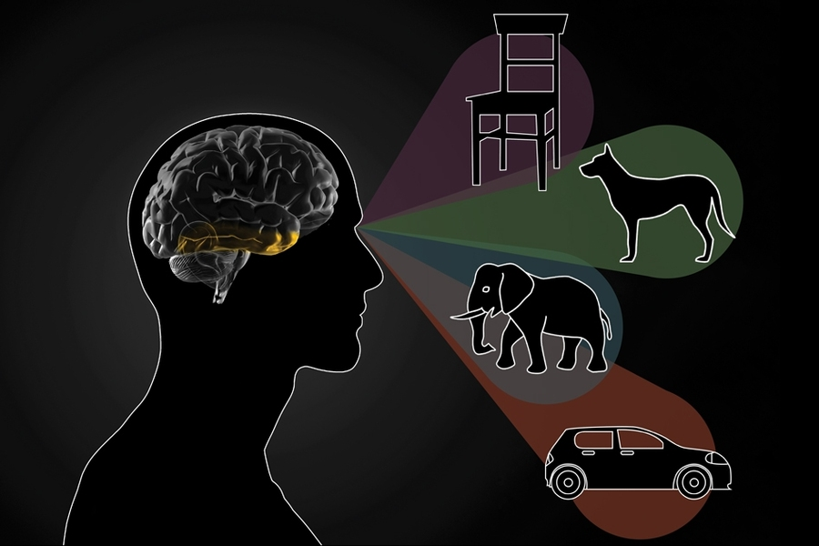
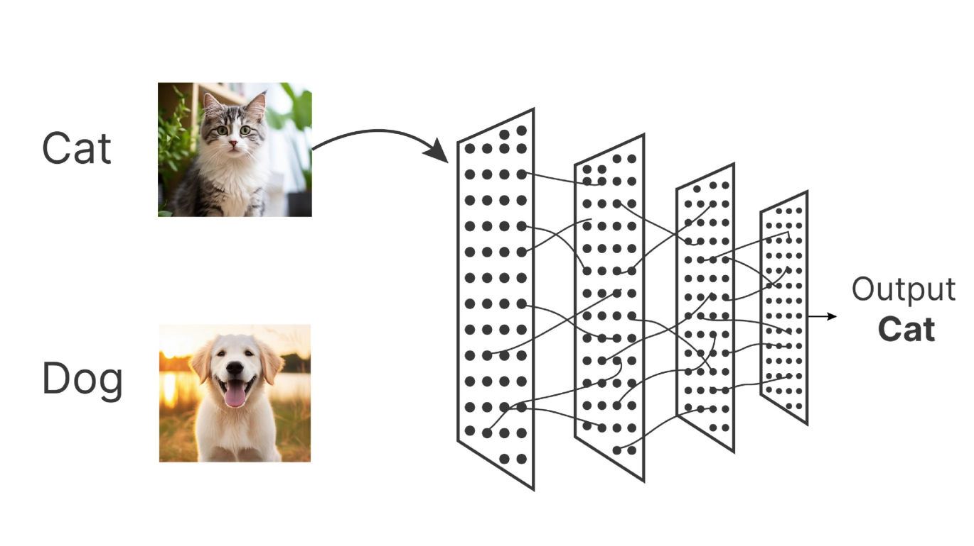

Slide 5
Convolution
The CNN uses a mathematical operation called convolution to extract features.
What is a Convolution?
It’s when a small matrix called a filter
(kernel) slides over the image and
multiplies overlapping values to create a feature map.
Example: If you have a 5×5 image and apply a 3×3 filter:
The filter moves step by step over the image
Each time, it computes a dot product between filter and image region
The result is a smaller feature map highlighting patterns like edges or corners

Slide 6
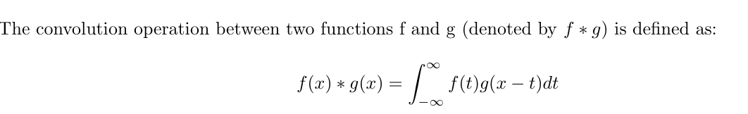
Convolution
Convolution essentially combines the information of the two input functions by measuring the overlap be tween them at every point and integrating the product over the entire range of possible shifts.
This operation is often visualized as sliding one function (g) over another (f), multiplying them at each point of overlap, and summing up the results.

Slide 7
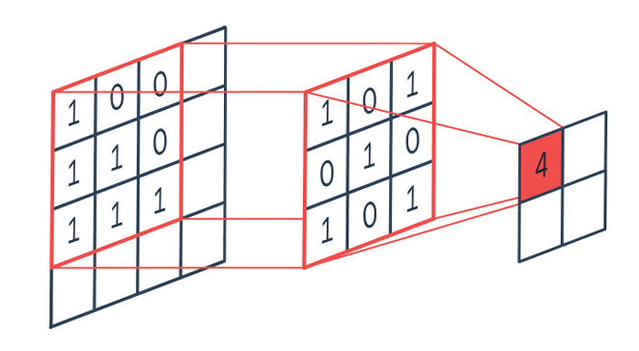
Convolution
Fig: Matrix Convolution

Slide 8
Convolution
Image:
1 | 0 | 1 | 0 | 0 | 1
Filter:
-1 | +1
Output
1
Operation: $\left(f∗g\right)\%2$

Slide 9
Convolution
Image:
1 | 0 | 1 | 0 | 0 | 1
Filter:
-1 | +1
Output
1 | 1
Operation: $\left(f∗g\right)\%2$

Slide 10
Convolution
Image:
1 | 0 | 1 | 0 | 0 | 1
Filter:
-1 | +1
Output
1 | 1 | 1
Operation: $\left(f∗g\right)\%2$

Slide 11
Convolution
Image:
1 | 0 | 1 | 0 | 0 | 1
Filter:
-1 | +1
Output
1 | 1 | 1 | 0
Operation: $\left(f∗g\right)\%2$

Slide 12
Convolution
Image:
1 | 0 | 1 | 0 | 0 | 1
Filter:
-1 | +1
Output
1 | 1 | 1 | 0
Operation: $\left(f∗g\right)\%2$

Slide 13
Convolution
Image:
1 | 0 | 1 | 0 | 0 | 1
Filter:
-1 | +1
Output
1 | 1 | 1 | 0 | 1
Operation: $\left(f∗g\right)\%2$

Slide 14
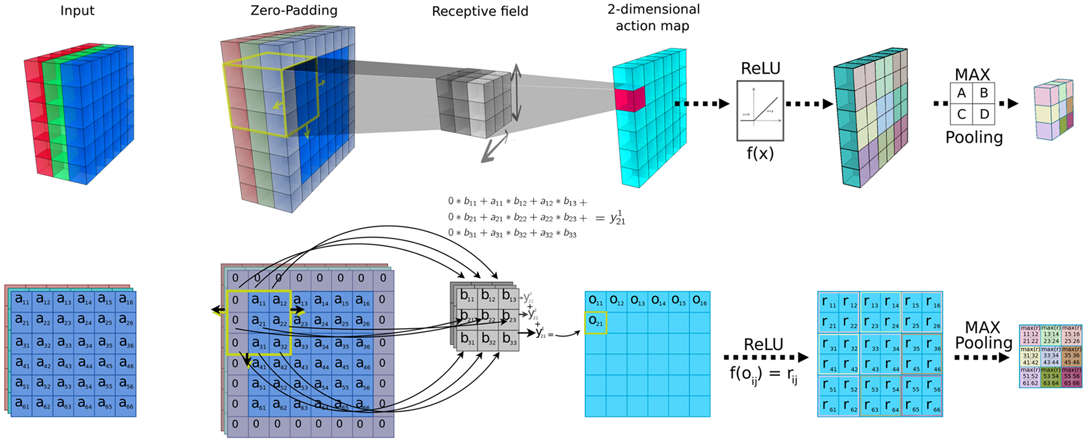
CNN to Dimension Reduction

Slide 15
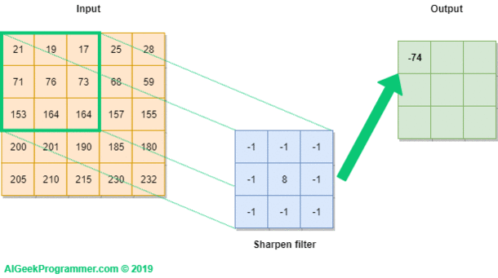
Example of CNN Filter

Slide 16
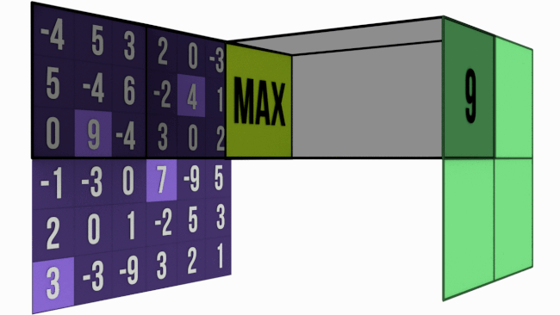

Slide 17
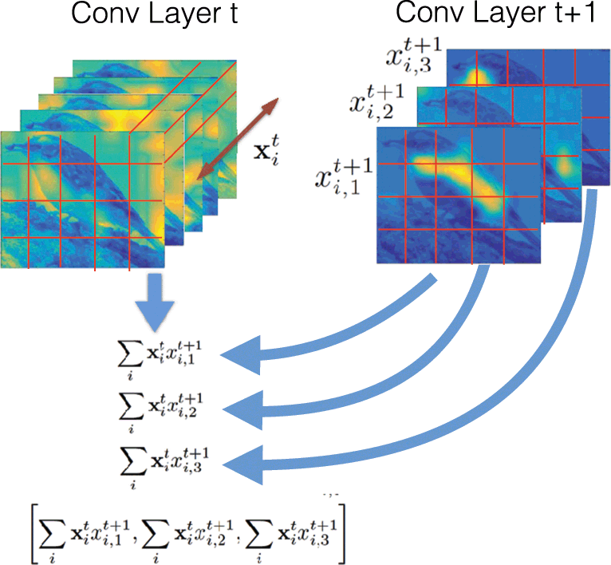

Slide 18
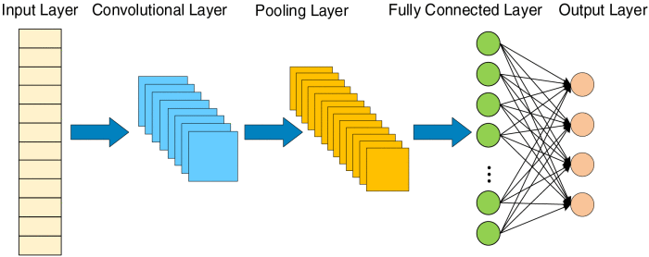
Complete Architecture of CNN

Slide 19
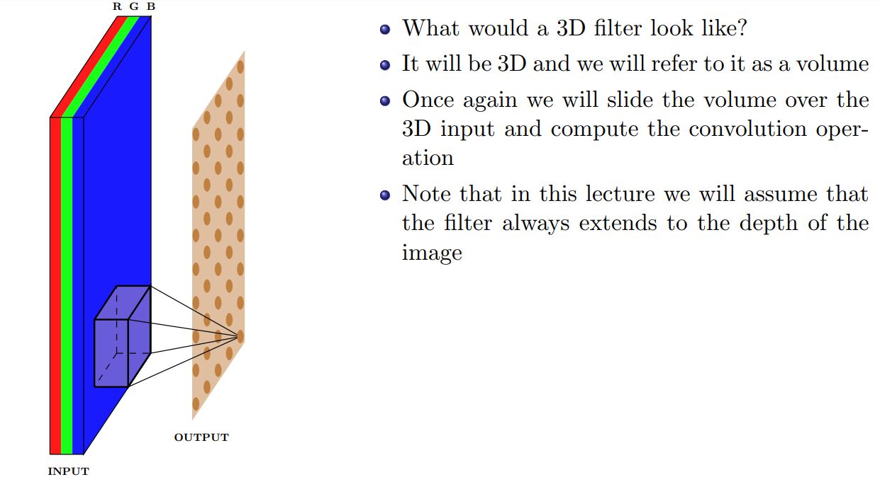
3D Filters

Slide 20
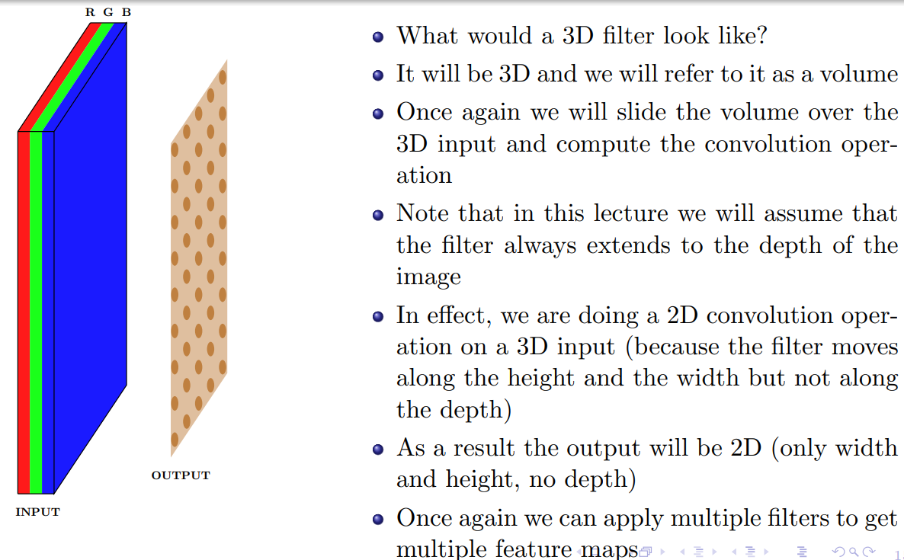
3D Filters

Slide 21
Relation between input size, output size and filter size
So far we have not said anything about the dimensions of the
- Inputs
- filters
- outputs
and the relations between them
We will see how they are related but before that we will define a few quantities

Slide 22
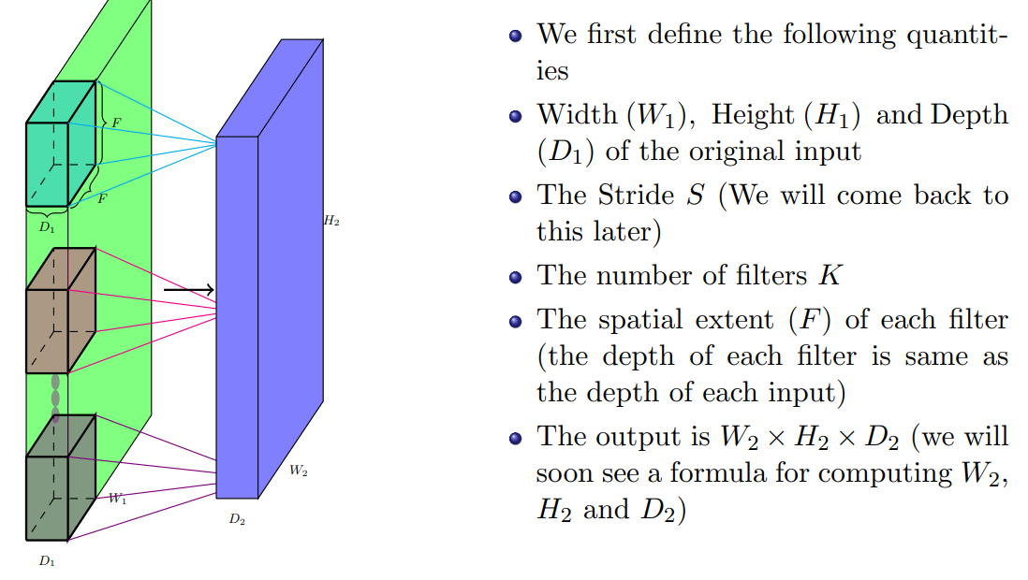
Relation between input size, output size and filter size

Slide 23
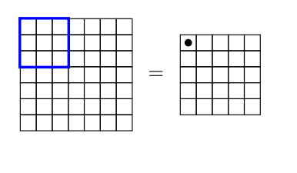
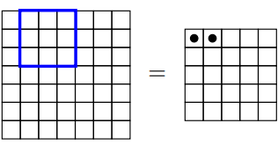
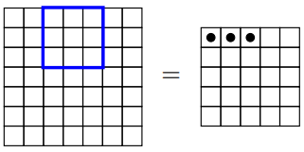
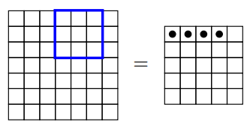
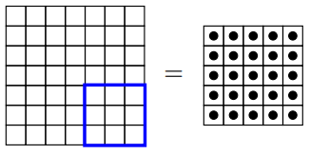
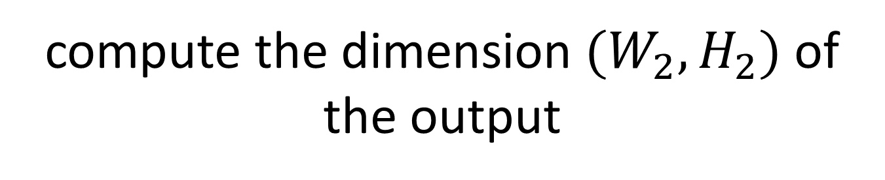
compute the dimension $(W_{2}, H_{2})$of the output

Slide 24
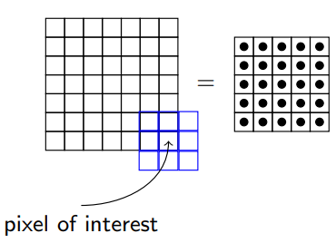
compute the dimension $(W_{2}, H_{2})$of the output
Notice that we can’t place the kernel at the corners as it will cross the input boundary

Slide 25
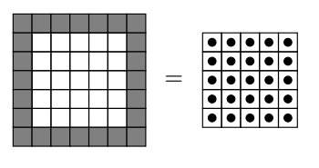
compute the dimension $(W_{2}, H_{2})$of the output
This is true for all the shaded points (the kernel crosses the input boundary)
This results in an output which is of smaller dimensions than the input
As the size of the kernel increases, this becomes true for even more pixels

Slide 26
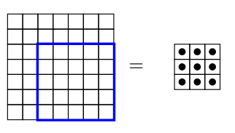
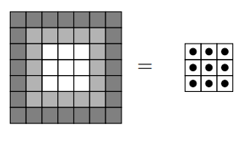
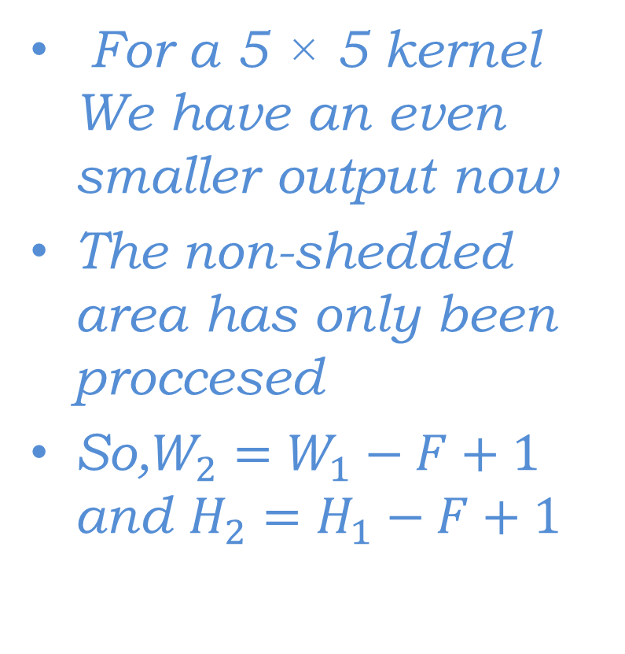
compute the dimension $(W_{2}, H_{2})$of the output
For a 5 × 5 kernel We have an even smaller output now
The non-shedded area has only been proccesed
So,$W_{2}=W_{1}−F+1$ and $H_{2}=H_{1}−F+1$

Slide 27
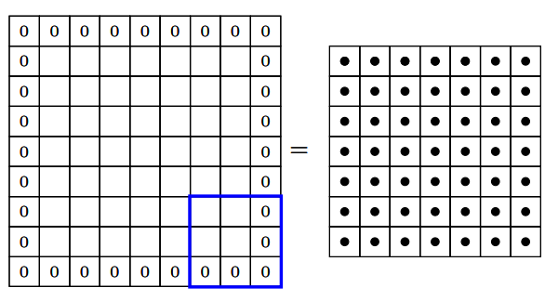
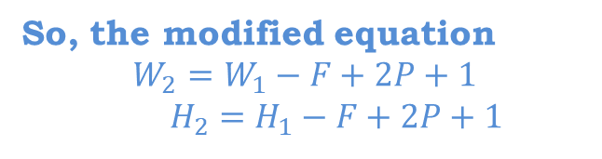
What if We want the same size ?
We can use something known as padding
Pad the inputs with appropriate number of 0 inputs so that you can now apply the kernel at the corners.
Let us use pad P = 1 with a 3 × 3 kernel.
This means we will add one row and one column of 0 inputs at the top, bottom, left and right
So, the modified equation
$$W_{2}=W_{1}−F+2P+1$$
$H_{2}=H_{1}−F+2P+1$

Slide 28
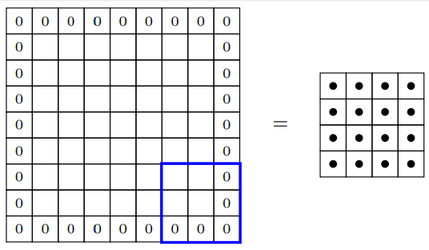
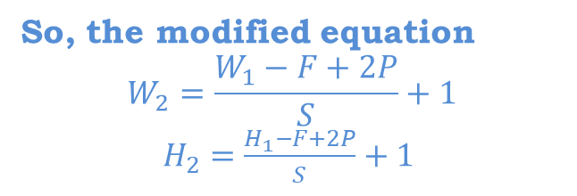
Impact of Stride(S)
It defines the intervals at which the filter is applied (here S = 2)
Here, we are essentially skipping every 2nd pixel which will again result in an output which is of smaller dimensions
So, the modified equation
$$W_{2}=\frac{W_{1}−F+2P}{S}+1$$
$H_{2}=\frac{H_{1}−F+2P}{S}+1$

Slide 29
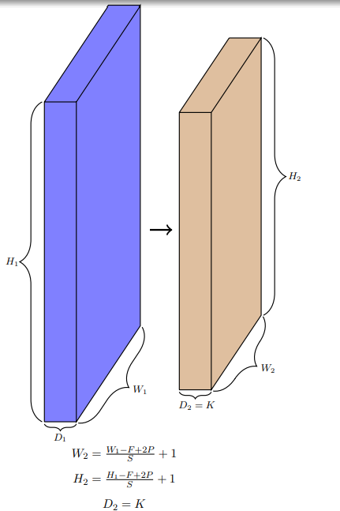
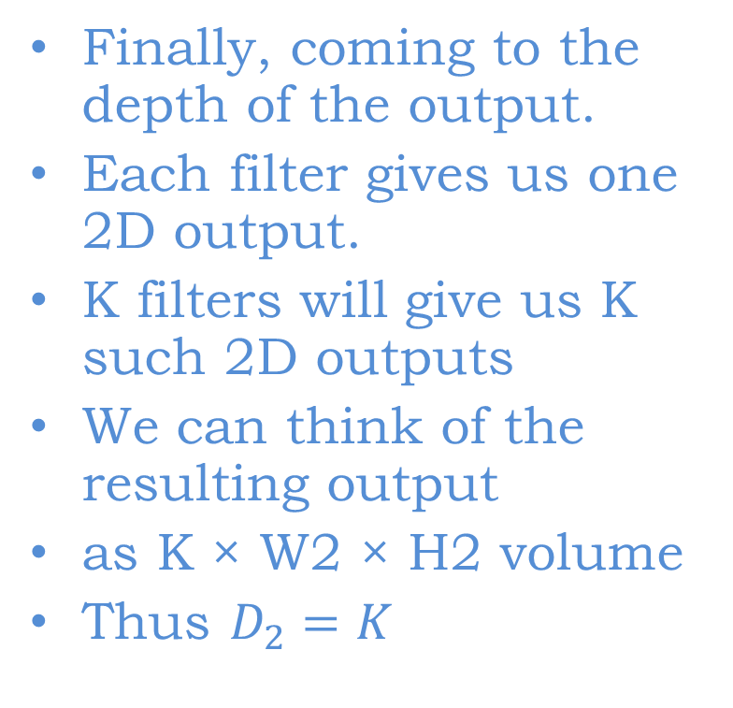
Depth?
Finally, coming to the depth of the output.
Each filter gives us one 2D output.
K filters will give us K such 2D outputs
We can think of the resulting output
as K × W2 × H2 volume
Thus $D_{2}=K$

Slide 30
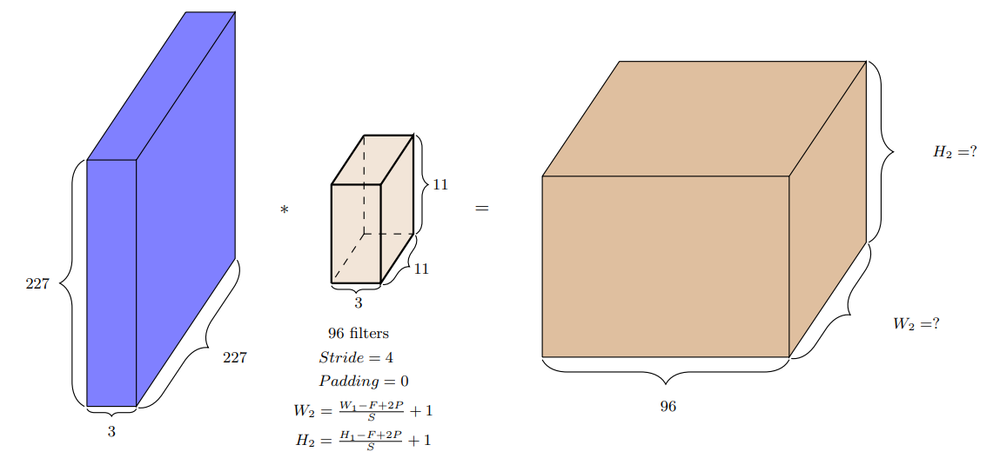

Slide 31
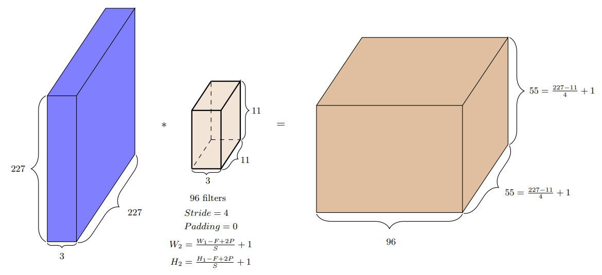

Slide 32
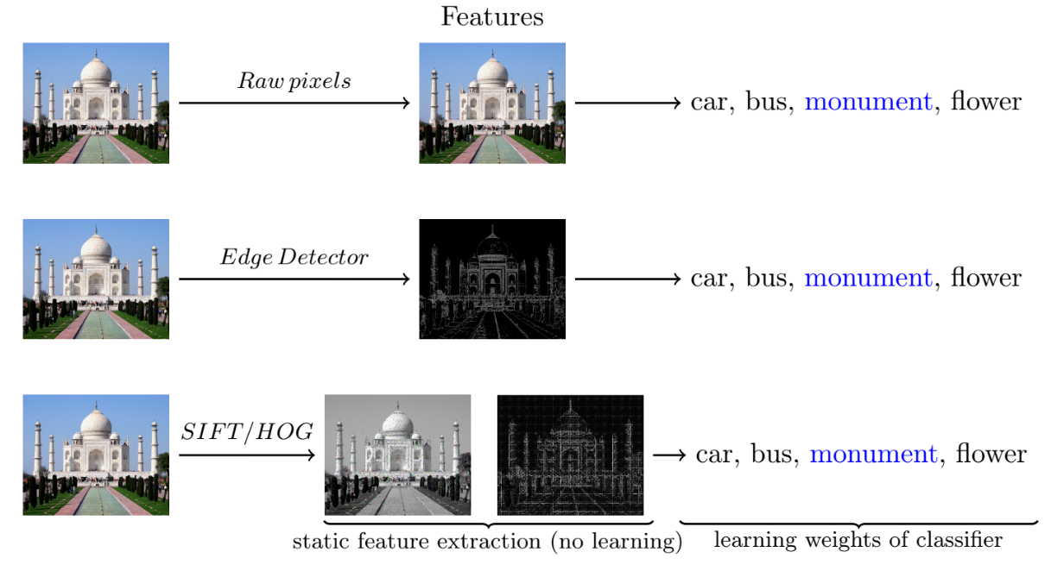

Slide 33
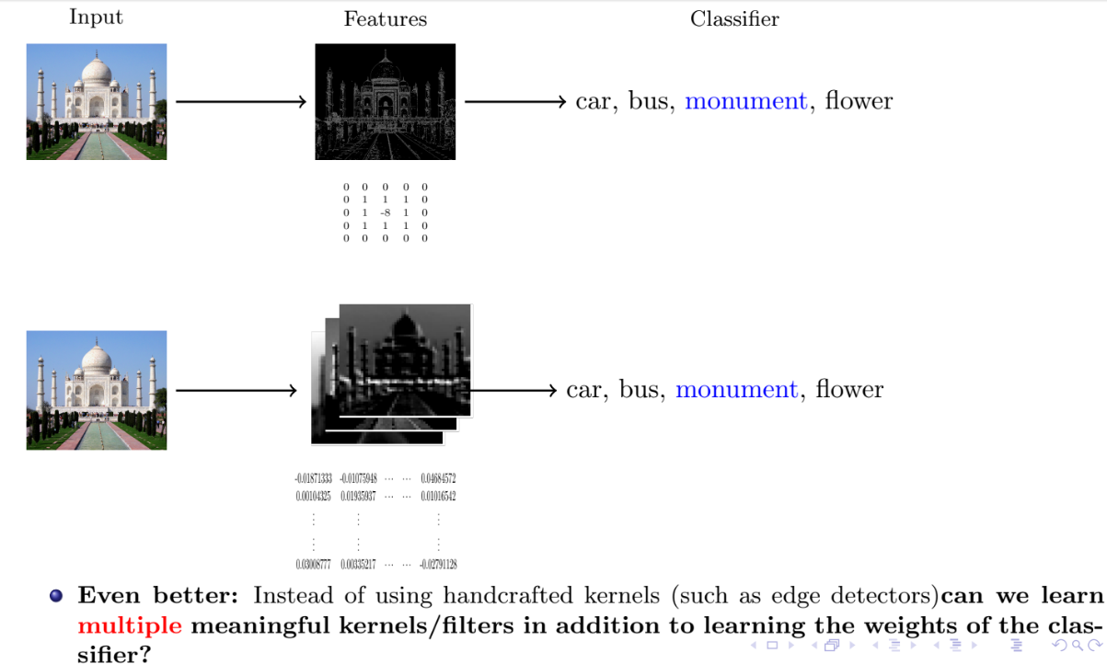

Slide 34
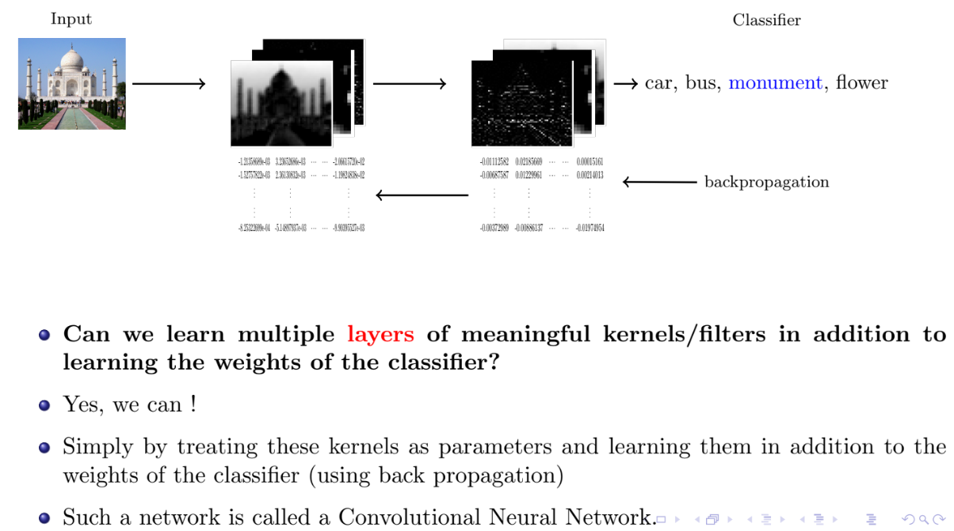

Slide 35
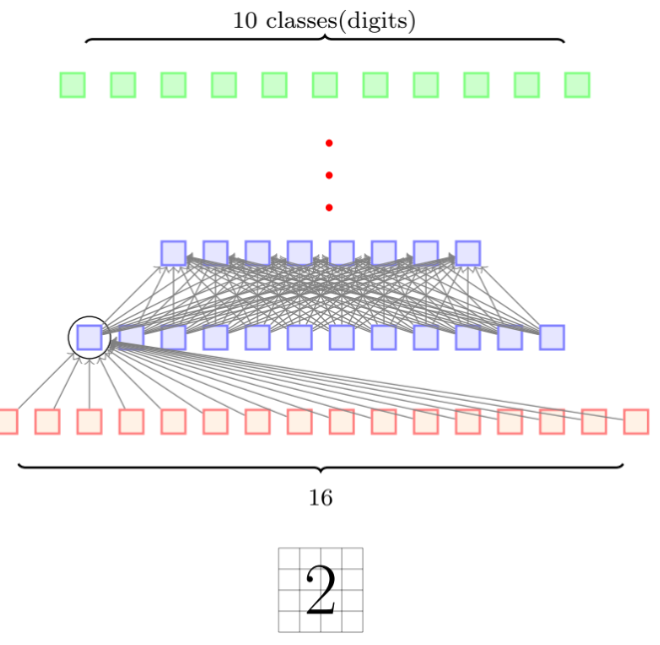
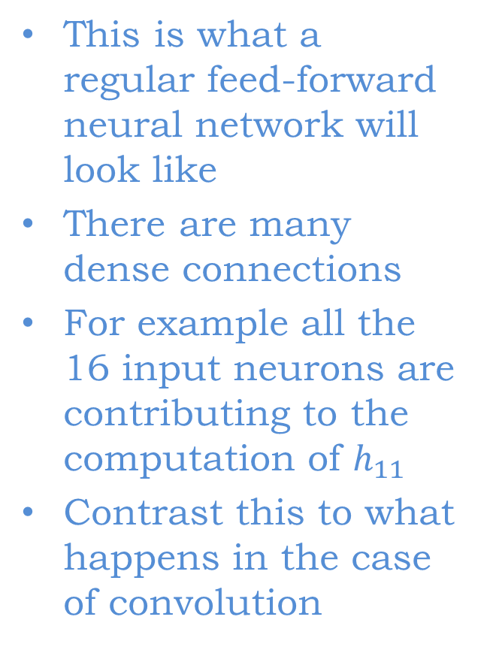
Sparse Connectivity
This is what a regular feed-forward neural network will look like
There are many dense connections
For example all the 16 input neurons are contributing to the computation of $h_{11}$
Contrast this to what happens in the case of convolution

Slide 36
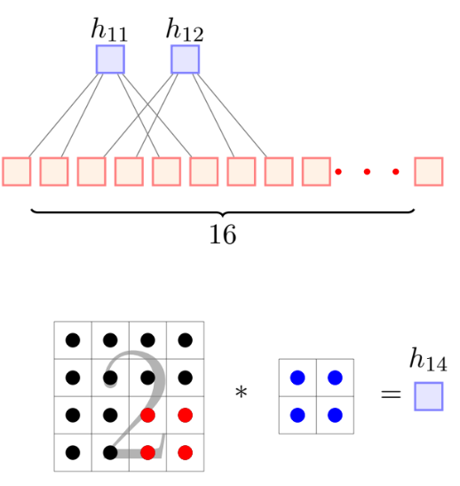
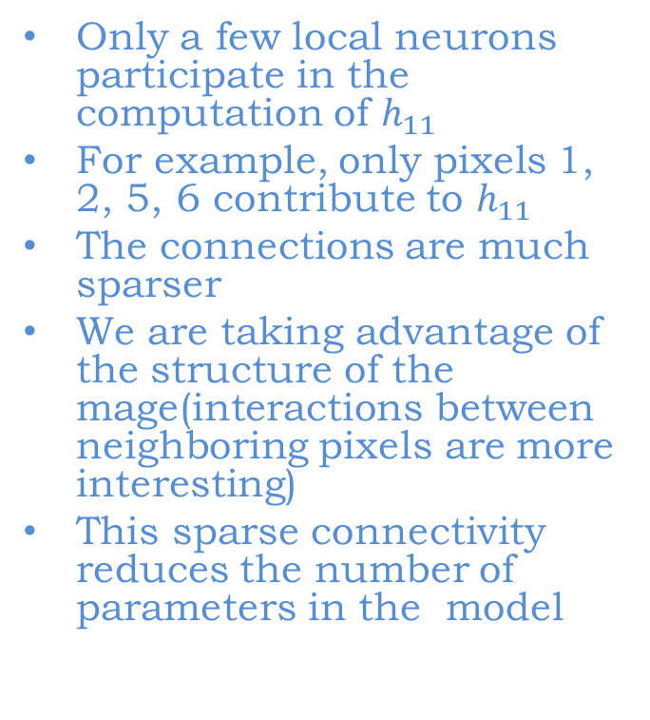
Sparse Connectivity
Only a few local neurons participate in the computation of $h_{11}$
For example, only pixels 1, 2, 5, 6 contribute to $h_{11}$
The connections are much sparser
We are taking advantage of the structure of the mage(interactions between neighboring pixels are more interesting)
This sparse connectivity reduces the number of parameters in the model

Slide 37
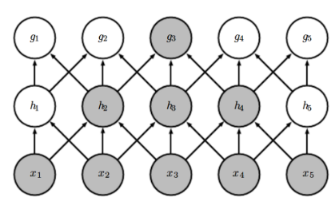
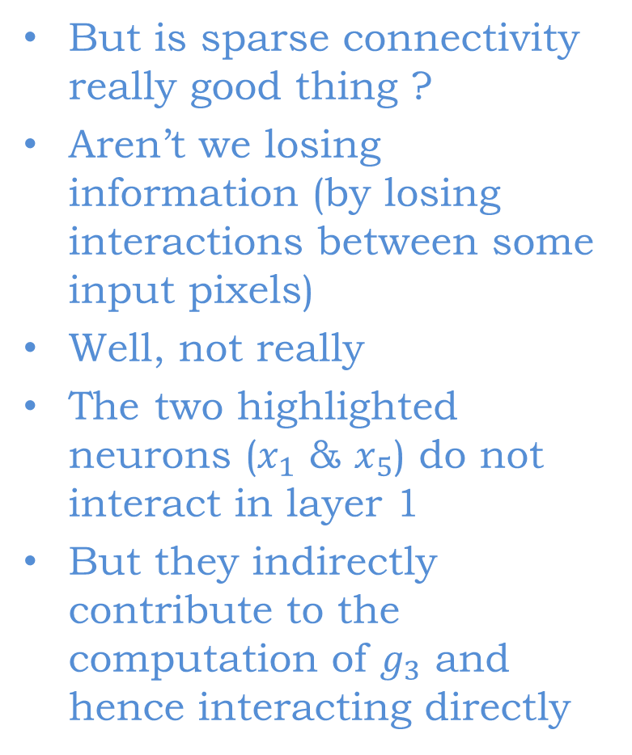
Sparse Connectivity
But is sparse connectivity really good thing ?
Aren’t we losing information (by losing interactions between some input pixels)
Well, not really
The two highlighted neurons ($x_{1}$ & $x_{5}$) do not interact in layer 1
But they indirectly contribute to the computation of $g_{3}$ and hence interacting directly

Slide 38
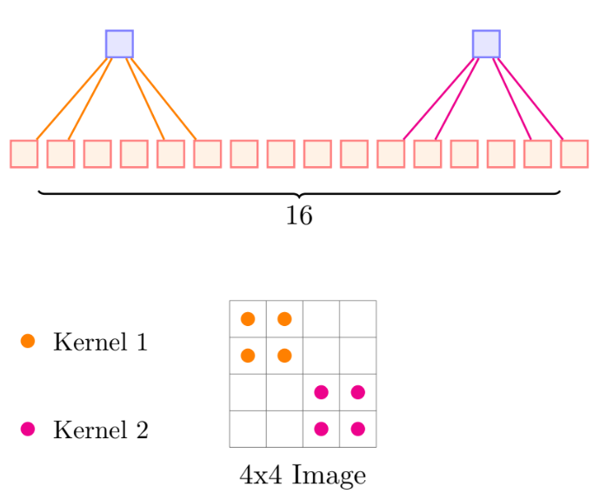
Weight Sharing
Consider the following network
Do we want the kernel weights to be different for different portions of the image?
Imagine that we are trying to learn a kernel that detects edges
Shouldn’t we be applying the same kernel at all the portions of the image?

Slide 39
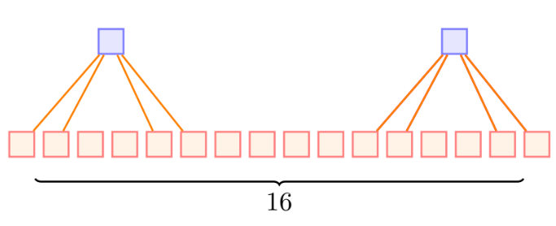
Weight Sharing
In other words shouldn’t the orange and pink kernels be the same
Yes, indeed
This would make the job of learning easier(instead of trying to learn the same weights/kernels at different locations again and again)
But does that mean we can have only one kernel?
No, we can have many such kernels but the kernels will be shared by alllocations in the image

Slide 40
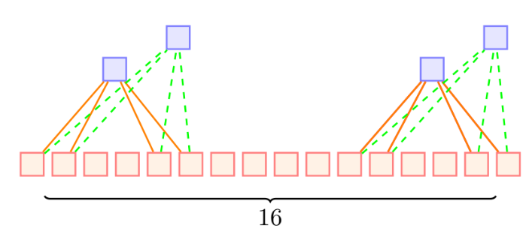
Weight Sharing
In other words shouldn’t the orange and pink kernels be the same
Yes, indeed
This would make the job of learning easier(instead of trying to learn the same weights/kernels at different locations again and again)
But does that mean we can have only one kernel?
No, we can have many such kernels but the kernels will be shared by alllocations in the image

Slide 41
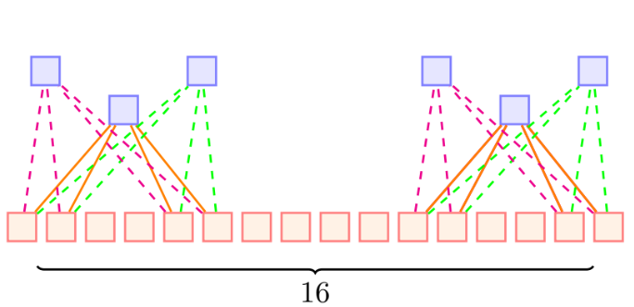
Weight Sharing
In other words shouldn’t the orange and pink kernels be the same
Yes, indeed
This would make the job of learning easier(instead of trying to learn the same weights/kernels at different locations again and again)
But does that mean we can have only one kernel?
No, we can have many such kernels but the kernels will be shared by allocations in the image
This is called “weight sharing”

Slide 42
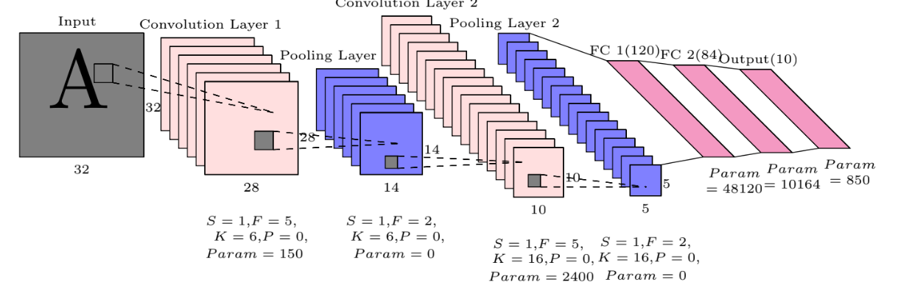
Example of Complete CNN

Slide 43
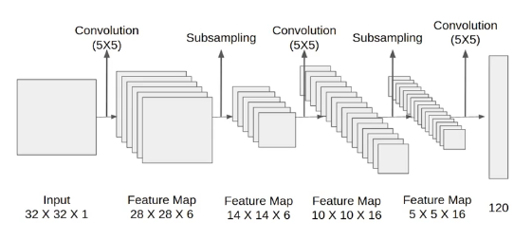
LeNet-5 Architecture

Slide 44
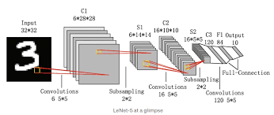
LeNet-5 Digit Recognition

Slide 45
CNN on ImageNet
AlexNet
ZFNet
GoogleNet

Slide 46
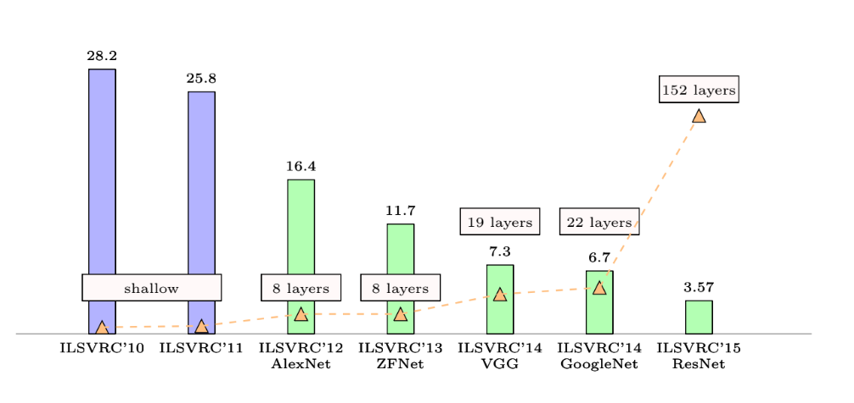
Performance Comparison On Different Deep Network

Slide 47
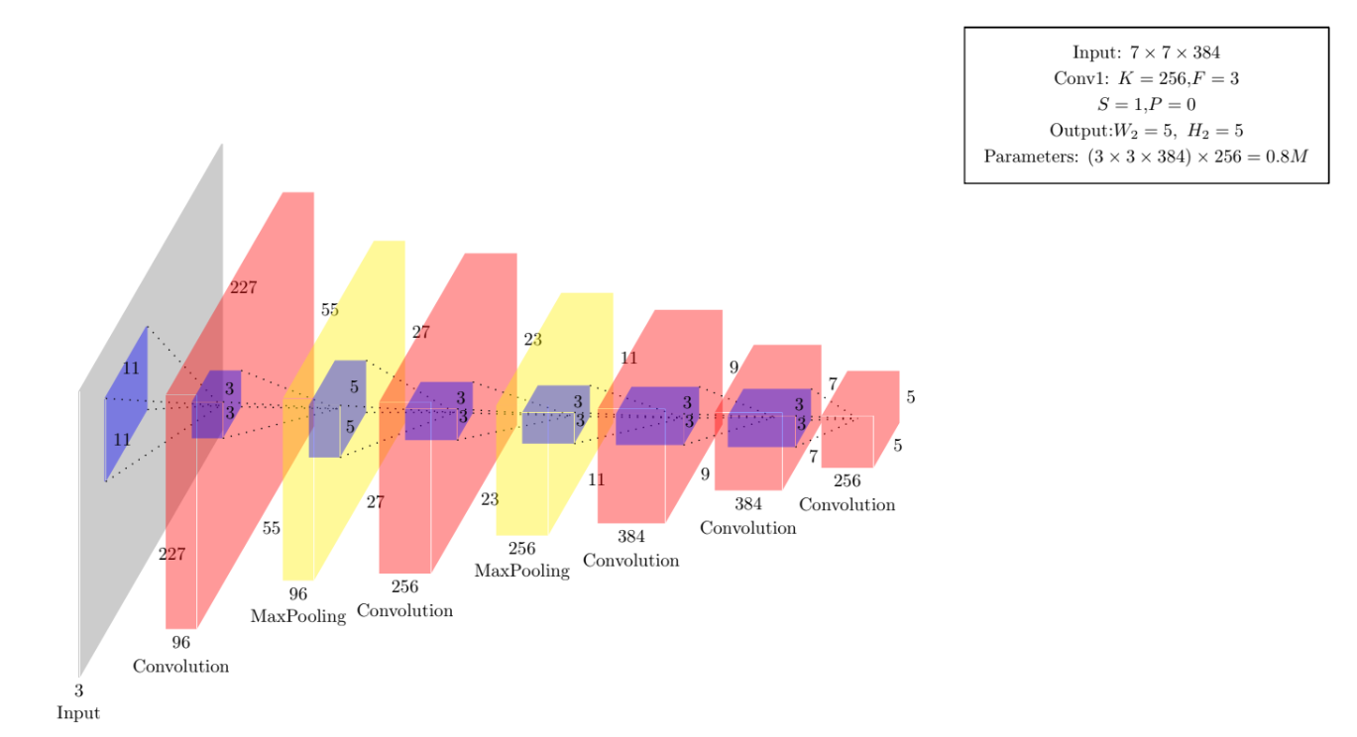
AlexNet

Slide 48
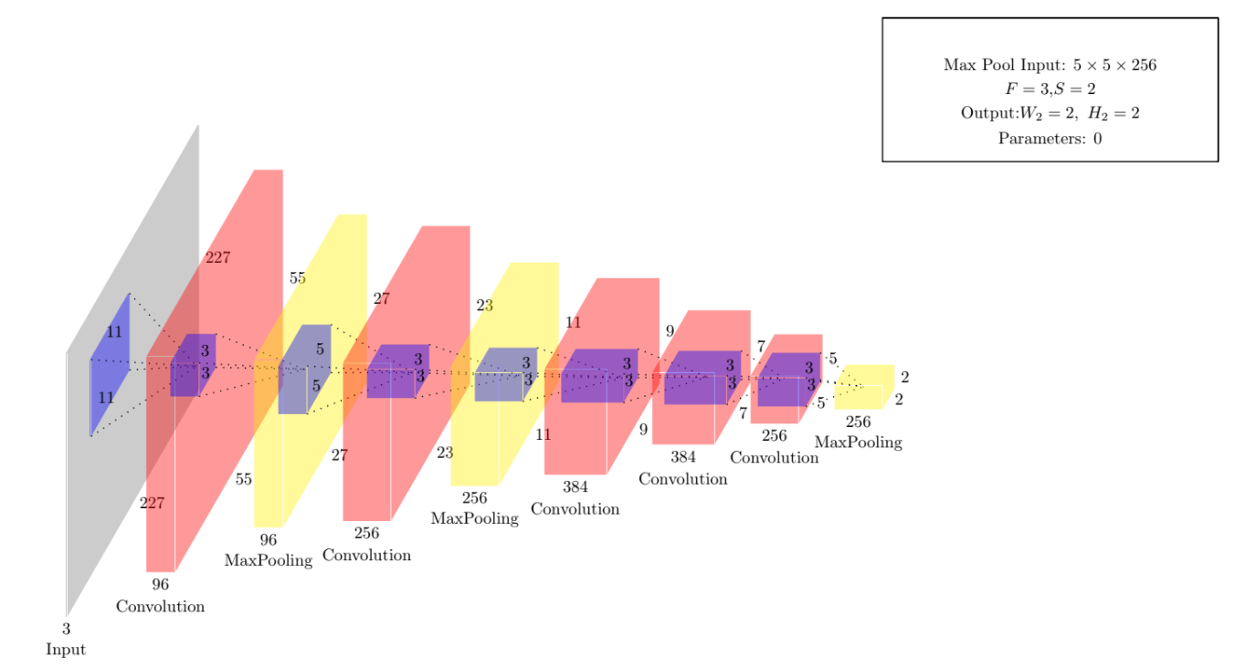
AlexNet

Slide 49

AlexNet

Slide 50

AlexNet

Slide 51

AlexNet

Slide 52

AlexNet

Slide 53

ZFNet

Slide 54

ZFNet

Slide 55

ZFNet

Slide 56

ZFNet

Slide 57

ZFNet

Slide 58

ZFNet

Slide 59

ZFNet

Slide 60

ZFNet

Slide 61

ZFNet

Slide 62

ZFNet

Slide 63

ZFNet

Slide 64

ZFNet

Slide 65

VGGNet

Slide 66

GoogleNet

Slide 67

GoogleNet

Slide 68

GoogleNet

Slide 69

GoogleNet

Slide 70

GoogleNet

Slide 71

GoogleNet

Slide 72

GoogleNet

Slide 73

GoogleNet

Slide 74

GoogleNet

Slide 75

GoogleNet

Slide 76

GoogleNet

Slide 77

GoogleNet

Slide 78

GoogleNet

Slide 79

GoogleNet

Slide 80

GoogleNet

Slide 81

GoogleNet

Slide 82

ResNet

Slide 83

ResNet

Slide 84

ResNet

Slide 85

ResNet

Slide 86

ResNet

Slide 87

ResNet

Slide 88
Visualizing Convolutional Neural Networks
Visualizing Patches
Visualizing Filters

Slide 89

Visualizing patches which maximally activate a neuron

Slide 90

Visualizing patches which maximally activate a neuron

Slide 91

Visualizing patches which maximally activate a neuron

Slide 92

Visualizing patches which maximally activate a neuron

Slide 93

Visualizing patches which maximally activate a neuron

Slide 94

Visualizing patches which maximally activate a neuron

Slide 95

Visualizing patches which maximally activate a neuron

Slide 96

Visualizing filters of a CNN

Slide 97

Visualizing filters of a CNN

Slide 98

Finding influence of input pixels using backpropagation

Slide 99

Finding influence of input pixels using backpropagation

Slide 100

Finding influence of input pixels using backpropagation

Slide 101

Finding influence of input pixels using backpropagation

Slide 102

Guided Backpropagation

Slide 103

Guided Backpropagation

Slide 104

Guided Backpropagation

Slide 105
Deep Dream
DeepDream is a neural network visualization technique that helps us see what a trained CNN “sees.” It takes an input image and feeds it through a trained CNN (like one trained for object recognition), but instead of classifying the image, it modifies the image to amplify the features that the network detects.

Slide 106
Deep Dream
How It Works
Start with a pretrained CNN (e.g., Inception, VGG).
Feed an image into the network.
Choose a specific layer — early layers detect edges, later layers detect objects.
Compute the gradient of the activations in that layer with respect to the input image.
Adjust the pixels of the image slightly to increase those activations (gradient ascent).
Repeat the process — the image gradually becomes filled with hallucinated features that the network “thinks” it sees.

Slide 107

Deep Dream

Slide 108

Deep Dream

Slide 109

Deep Dream

Slide 110
Deep Art
At its core, DeepArt applies the artistic style of one image (say, Van Gogh’s Starry Night) to the content of another image (say, your selfie or landscape photo). The result looks like your photo painted by Van Gogh.

Slide 111

Deep Art

Slide 112
Deep Art
Here’s how it works step by step:
Take two images:
A content image (e.g., your photo)
A style image (e.g., Van Gogh’s Starry Night)
Pass both through a pretrained CNN (like VGG-19 trained on ImageNet).
Extract two types of features:
Content features → what the image shows (shapes, structure)
Style features → what the image looks like (colors, brush strokes, texture)
Start with a random image (or a copy of the content image) and iteratively adjust it to:
Minimize content loss (difference from your photo)
Minimize style loss (difference from painting’s texture)
The optimization continues until the generated image retains the content of your photo but adopts the style of the painting.
Acknowledgement: DeepArt is based on a 2015 paper by Leon A. Gatys, Alexander Ecker, and Matthias Bethge titled “A Neural Algorithm of Artistic Style.”

Slide 113

Deep Art

Slide 114

Deep Art

Slide 115

Deep Art

Slide 116

Deep Art

Slide 117
Fooling Deep CNN
“Fooling” deep convolutional neural networks refers to creating inputs that make a trained CNN produce wrong or surprising outputs (often with high confidence) while the inputs look unchanged or harmless to humans. These are called adversarial examples / fooling examples, and they reveal important vulnerabilities in modern vision models.

Slide 118
Fooling Deep CNN: Types of Attack
Small perturbations: tiny, often imperceptible pixel changes that cause misclassification (e.g., FGSM / iterative attacks).
Stronger optimization attacks: attacks that solve an optimization problem to find minimal perturbations (e.g., Carlini–Wagner attacks). These can break many naïve defenses.
Projected Gradient Descent (PGD) and iterative attacks — a widely used strong evaluation method and the basis for adversarial training.
Universal perturbations / fooling images: a single perturbation works for many inputs, or synthetic images that networks classify confidently but humans cannot recognize.
Adversarial patches & physical attacks: localized printed stickers or patches that, when placed in a scene, cause detectors/classifiers to fail even in real photos.

Slide 119
Fooling Deep CNN: Intuition
High-dimensional inputs + complex decision boundaries make tiny changes cross class boundaries.
Many models behave like (locally) linear functions in high-dimensional pixel space; linearity explains why small coordinated changes add up. (Goodfellow’s FGSM paper gives this intuition.)

Slide 120
Defenses — status and challenges
Adversarial training (train on strong adversarial examples, e.g., PGD-trained models) is currently one of the most effective empirical defenses. It trades off some clean accuracy and is expensive to train.
Input transformations / preprocessing (JPEG compression, bit-depth reduction, denoising) sometimes help but are often circumventable.
Provable / certified defenses (e.g., randomized smoothing, verification methods) provide guarantees under specific threat models but often restrict model capacity or apply only to small perturbation radii. Recent surveys summarize progress and limits.
Evaluation is hard: many proposed defenses were later broken by stronger attacks — robust evaluation requires testing against state-of-the-art attacks (white-box), adaptive attackers, and multiple norms/metrics. Carlini & Wagner’s work is a classic demonstration that evaluations must be strong and adaptive.

Slide 121

Fooling Deep CNN

Slide 122

Fooling Deep CNN

Slide 123

Fooling Deep CNN

Slide 124

Fooling Deep CNN

